Slide 1

Rock Detector

Slide 2

Supervised By:
Dr. Ahmed Hamza, Assistant professor Faculty of computer and Information Technology at EELU
Eng. Dyaa El-dein, Teaching Assistant Faculty of Computer and Information Technology at EELU

Slide 3
Team Members
21- 00466
21- 00530
21- 01749
Ali Mohamed Ahmed
Asr Mohamed Rokaby
Youssef Khaled Mohamed
21- 01412
Omar Mohamed Zaki
21- 01264
Mohamed Mokhtar Abd-Elsalam
21- 01256
Mohamed Mahmoud Ali Madany
21- 01266
Mohamed Abd-Allah Attia
21- 01263
Mohamed Ahmed Altaher

Slide 4







Agenda
Introduction
Methodology
Problem Statement
Demo
Literature
Review
References
Background

Slide 5

Introduction

Slide 6

Importance of Mineral Resources:
Minerals play an important role in fields like construction, technology, and Medicine.

Slide 7



Minerals In different fields

Slide 8

Technology
Electronics: Silicon extracted from sand is used in semiconductor manufacturing for processors and microchips.
Batteries: Lithium, found in rocks like spodumene, is used in lithium-ion batteries for electronic devices and electric vehicles.
Fiber optics: Quartz (silicon dioxide) is used in the production of fiber optic cables, enabling high-speed internet transmission.

Slide 9

Medicine
Disease treatment: Radioactive rocks like uranium are used in radiation therapy for cancer treatment.

Slide 10
Industry
Construction materials & Cement: Granite, marble, and limestone are used in construction, decoration, and flooring.
Oil and natural gas: Sedimentary rocks such as sandstone and shale act as reservoirs for oil and natural gas.

Slide 11

EGY 2030
1. Development of the Mining Sector and Rock-Related Industries
Egypt's Vision 2030 focuses on increasing the utilization of mineral resources and enhancing their value-added processes instead of exporting them as raw materials. This includes:
Accurate geological exploration using modern technology to improve mineral extraction.
Supporting local industries that rely on rocks, such as cement, marble, and ceramics.
2. Digital Transformation and Use of Advanced Technologies
The vision supports the use of artificial intelligence in various fields, including geology and mining, to enhance innovation and modernize traditional sectors.

Slide 12
Problem Statement

Slide 13
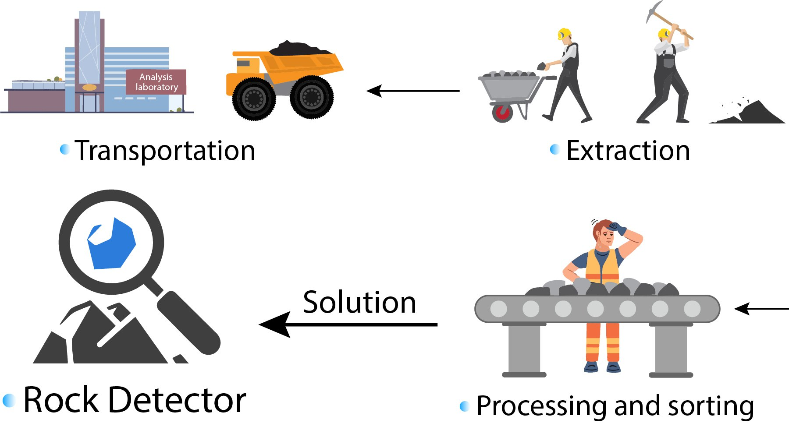
Traditional Method for Rock Classification

Slide 14
Cons of Traditional Rock Classification Methods:
Time-Consuming Physical examination and laboratory tests can take hours or even days to identify a rock sample accurately.
High Costs Requires expensive laboratory equipment, such as microscopes, spectrometers, or X-ray diffraction tools, which may not be accessible to everyone.
Dependency on Expertise Identification often depends on highly trained geologists or mineralogists, making it inaccessible to amateurs or field workers without specialized training.

Slide 15
Literature
Review

Slide 16

Papers Title | Published date | Dataset | Model | Paper Accuracy
Classifying Minerals using Deep Learning Algorithms(Tianjin University) [1] | 26 August 2019 | Local | Inception V3 | %99
Earth Science and its Role in the Future of Mineral Exploration(Xiamen University of Technology, Xiamen, China) [2] | 16 January 2023 | Local | ResNet-34 | %99
Classifying Minerals using Deep Learning Algorithms (National Institute of Technology Raipur) [3] | June 2022 | Local | ResNet-18 | 92%
Classifying Minerals using Deep Learning Algorithms(San Donato Milanese,Milan, Italy) [4] | 22 April 2023 | Local | ResNet-50 | 93%
Classification of Minerals using Deep Learning(China University of Geosciences) [5] | 29 August 2022 | Local | Inception | 86%
Unsupervised Learning and Mineral Classification(Gumushane University/ TÜRKİYE) [6] | 30 August 2024 | Local | ResNet-50 | 90%
Papers Summary

Slide 17
Background

Slide 18
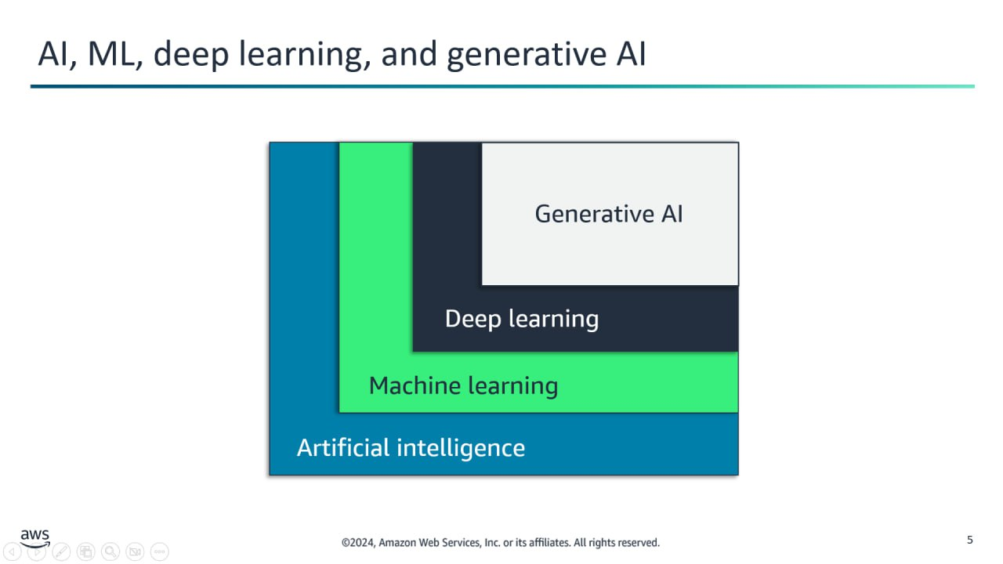
AI , ML ,
Deep Learning , and Generative AI

Slide 19
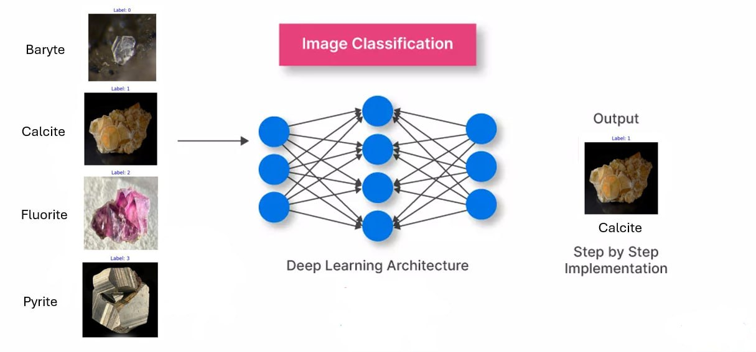



Image Classification
1. Why AI for Image Classification?
Imagine a doctor diagnosing a
disease from an X-ray, a self-driving
car recognizing traffic signs, or
geologists classifying rocks to identify
valuable minerals. Image
classification makes all of this
possible! It’s the brain that turns
images into smart decisions,
transforming our lives every day.

Slide 20
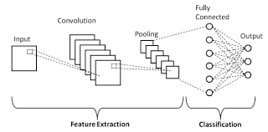
2. Role of Deep Learning in Image Classification
Convolutional Neural Networks (CNNs) are widely used in image classification because they can: Learn spatial hierarchies of features (edges, textures, patterns). Improve performance by leveraging pre-trained model
3. Why CNN for Our Project?
Traditional methods rely on handcrafted features, which can be time-consuming and less accurate.
AI, particularly Deep Learning, can automatically extract meaningful features from images, leading to higher accuracy and better generalization.
AI helps in:
Identifying patterns and textures in images.
Handling large-scale datasets efficiently.
Making accurate predictions with minimal human intervention.

Slide 21
Transfer Learning
Transfer learning is a machine learning technique where a model developed for a particular task is reused as the starting point for a model on a second task. This is particularly useful when the second task has limited data. Transfer learning leverages the knowledge gained from the first task to improve learning in the second task, often leading to better performance and faster training times.
ResNet
Inception
VGGNet

Slide 22
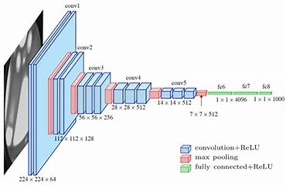
Transfer Learning
VGGNet
Overview: Developed by the Visual Geometry Group at Oxford, VGGNet is known for its simplicity and uniform architecture, using small 3x3 convolutional filters.
Architecture: Consists of deep
networks with 16 or 19 layers (e.g.,
VGG-16, VGG-19). Advantages: Uniform
architecture makes it easier to
implement and modify.
Image classification, object detection
for other tasks.
Applications:

Slide 23
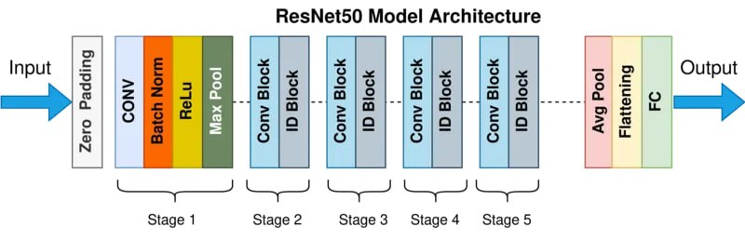
Transfer Learning
ResNet
Residual Networks, or ResNets,
learn residual functions with
reference to the layer inputs, instead
of learning unreferenced functions.
Instead of hoping each few stacked
layers directly fit a desired underlying
mapping, residual nets let these
layers fit a residual mapping.

Slide 24
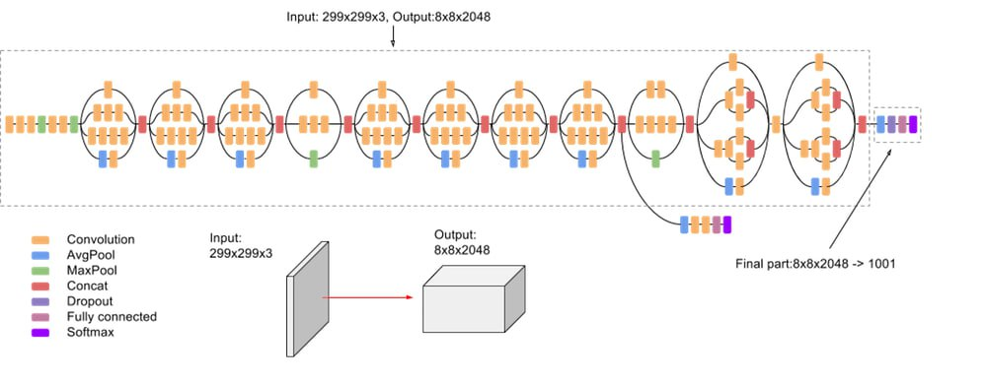
Transfer Learning
Inception
Inception Networks, or Inception
modules, are designed to capture
features at multiple scales within a
single layer. Instead of applying a single
convolutional filter size, Inception
Layers use parallel paths with different
Filter sizes (e.g., 1x1, 3x3, 5x5) and
pooling, allowing the network to learn
both fine and coarse features
simultaneously. These outputs are
concatenated, enhancing feature
diversity while maintaining
computational efficiency.

Slide 25
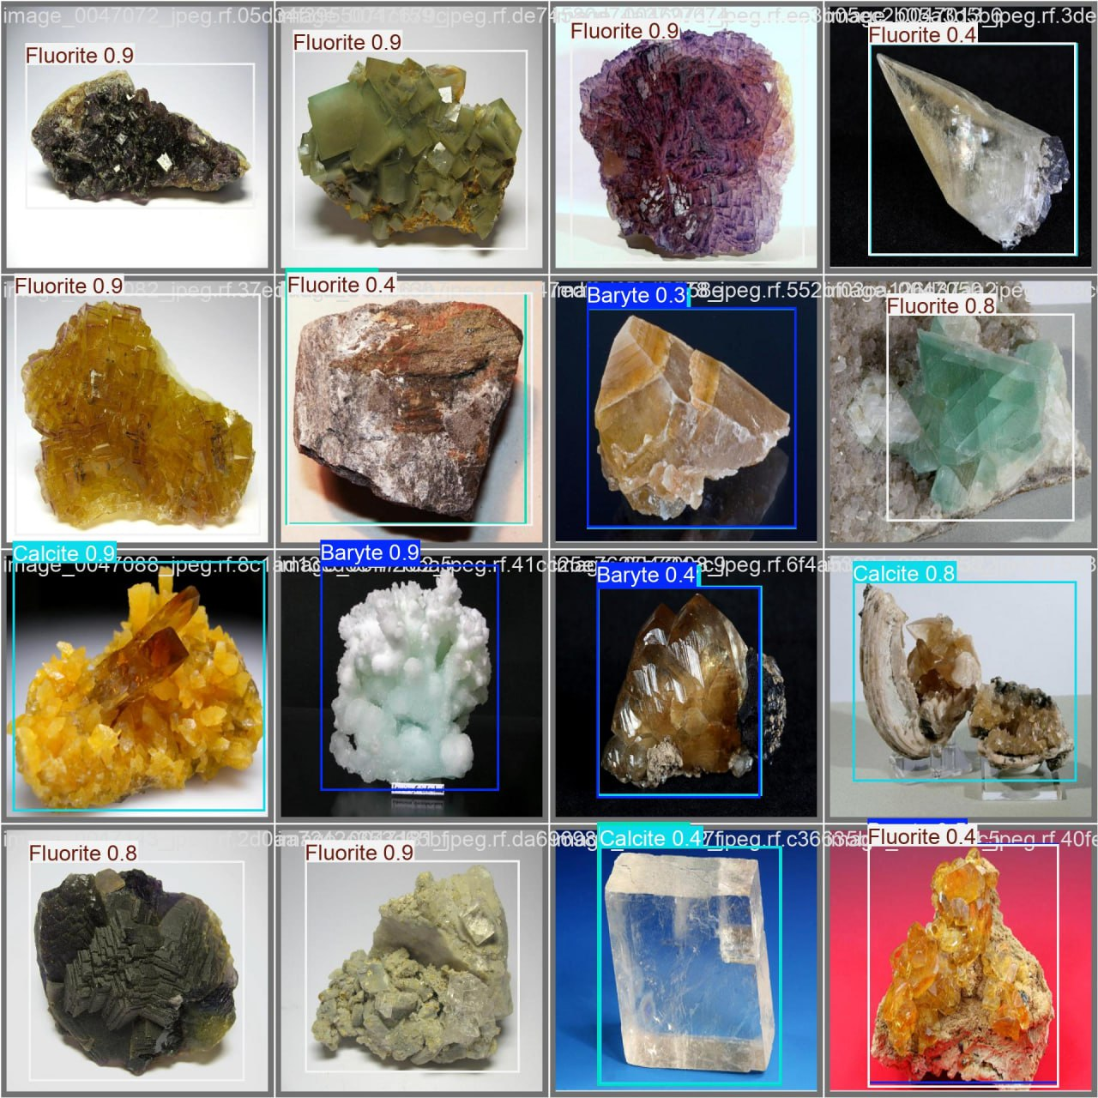
Object Detection
It is a vital computer vision technique that identifies and locates objects, like rocks, in images using bounding boxes. It combines localization to pinpoint object positions with classification to label them, enabling real-time analysis in varied settings.
This method is crucial for the project, supporting the mobile and web apps by detecting multiple rock types (Baryte, Calcite, Fluorite, Pyrite) efficiently, even in complex scenes

Slide 26
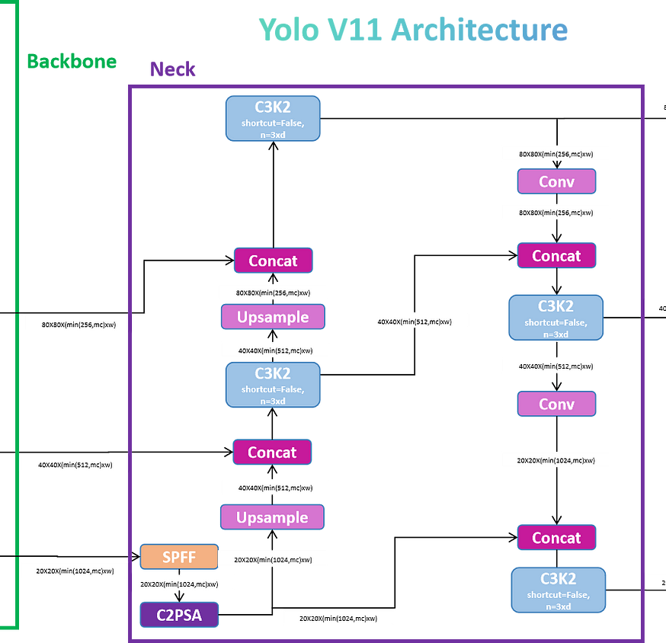
YOLO
The YOLO (You Only Look Once) family, especially YOLOv11 used in this project, is renowned for its speed and accuracy in real-time object detection. It processes images in one pass, detecting and classifying rocks with an mAP@0.5 of 0.831, ideal for user-friendly applications.
YOLOv11 outperforms older models by handling multiple classes simultaneously, making it a perfect fit for identifying rocks in diverse environments via the project’s interface.

Slide 27
Methodology

Slide 28
Technologies
Tools

Slide 29
1. What is Flutter ?!
Flutter is an open-source framework developed by Google for building applications that run on multiple platforms, including Android, iOS, Windows, and macOS, using a single codebase.
2. Why Using Flutter ?
Single Codebase for All Platforms – No need to write separate code for each operating system. High Performance – Uses a fast-rendering engine (Skia). Hot Reload – Allows developers to see real-time changes while coding. Modern UI Design – Provides tools for creating beautiful user interfaces. Large Community and Strong Support – Backed by Google and a vast developer community.

Slide 30

1. What is .NET ?!
.NET Core is a free, open-source, cross-platform framework developed by Microsoft for building modern, cloud-based, and high-performance applications. It is a modular, lightweight, and high-performance successor to the traditional .NET Framework, designed to work across Windows, Linux, and macOS.
2. Why Using .NET ?
Cross-Platform & Open-Source
High Performance & Scalability
Faster than Node.js, Python, and Java in many benchmarks Optimized for microservices & cloud-native apps (low memory usage, high throughput).
Unified Platform for All App Types Web Apps, Mobile Apps, Desktop Apps, Cloud & Microservices, APIs, Games and AI/ML
Supports multithreading & async/await (better than Python/Node.js for CPU-heavy tasks).

Slide 31

Microsoft SQL Server:
Key Features:
High-Performance Database Engine
Microsoft SQL Server stands out as a preferred RDBMS for developers due to its rich feature set, developer-friendly tools, and seamless integration with modern application ecosystems. It supports transactional processing, business intelligence, and cloud integration
Advanced Security Features
Developer-Friendly Tools
Scalability & Flexibility
Strong Ecosystem & Community

Slide 32


Python:
C Sharp:
C# is a modern, object-oriented, and type-safe programming language developed by Microsoft as part of the .NET initiative and is widely used for building Windows applications, web services, games, and mobile apps.Key Features Performance & Memory Management Object-Oriented Programming (OOP) Different Application development
Python is a high-level, interpreted, and general-purpose programming language known for its simplicity, readability, and versatility. Created by Guido van Rossum in 1991, Python has become one of the most popular programming languages worldwide, used in web development, data science, automation, artificial intelligence (AI)

Slide 33



HTML:
CSS:
JS:
Hypertext Markup Language is the standard markup language for documents designed to be displayed in a web browser. It defines the content and structure of web content
Cascading Style Sheets is a style sheet language used for specifying the presentation and styling of a document written in a markup language such as HTML or XML.
JavaScript is a versatile, high-level programming language that powers interactivity on the web. it has evolved into one of the most widely used languages in the world. Its features include Cross-Platform, Multi-Paradigm Language and Client-Side Scripting

Slide 34


What is Android Studio ?
The official Integrated Development Environment (IDE) from
What is VS code ?
A lightweight yet powerful code editor that supports many
Google for developing Android and Flutter applications, featuring:
- Emulator for testing apps on virtual devices. - Performance analysis tools to optimize code. - Built-in Flutter SDK support for seamless app development.
language). Key features: - Extensions support to enhance functionality. - User-friendly interface with customizable themes. - Debugging and Git integration for better development workflow.
programming languages, including Dart (Flutter’s

Slide 35

Development Tools For Mobile App
Flutter
VS Code
Android Studio
Photoshop
The used
mobile app
framework to
develop the
The text editor
where we
Write the code
The IDE that we used to display the app through its emulator
PS used to
design the
interface an

Slide 36
Project
Overview
Capture
Classification
Result
Through our mobile camera we can capture / Scan a rock and Uploading an image from our mobile storage
Using the integrated AI model, we classify the rock
The result of classification will be displayed on the app screen

Slide 37

Mobile App
Take a Photo
This button makes the user able to Capture an image using mobile camera to predict it.
Upload Media
This button makes the user able to upload an image stored in our storage to predict it.

Slide 38
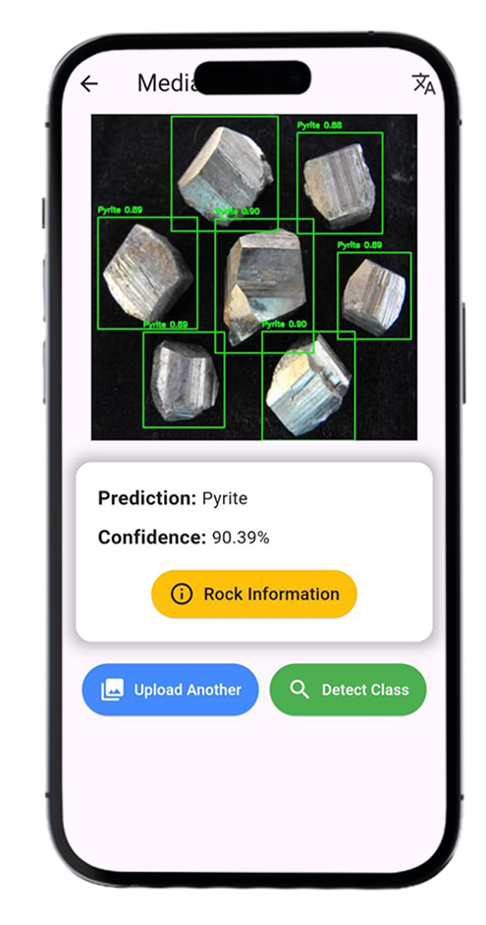
Result Page
Upload Another:
This button makes the user able to change the photo that was selected
Detect class:
This button sends the selected Picture to AI model and return the result 1-Prediction : The correct class for the picture 2-Confidence : The classification confidence rate
Rock Information
When click at this button, more information about the detected mineral will be displayed

Slide 39
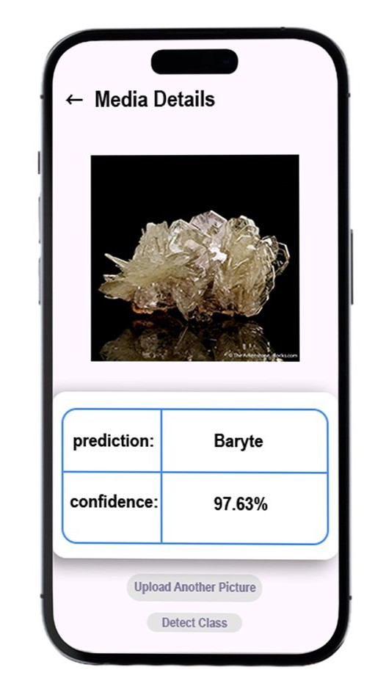
Mobile App V1
Detect class: This button sends the selected Picture to AI model and return the result 1-Prediction : The correct class for the picture 2-Confidence : The classification confidence rate
Upload Another Picture :
This button makes the user able to change the photo he selected
Result Page

Slide 40
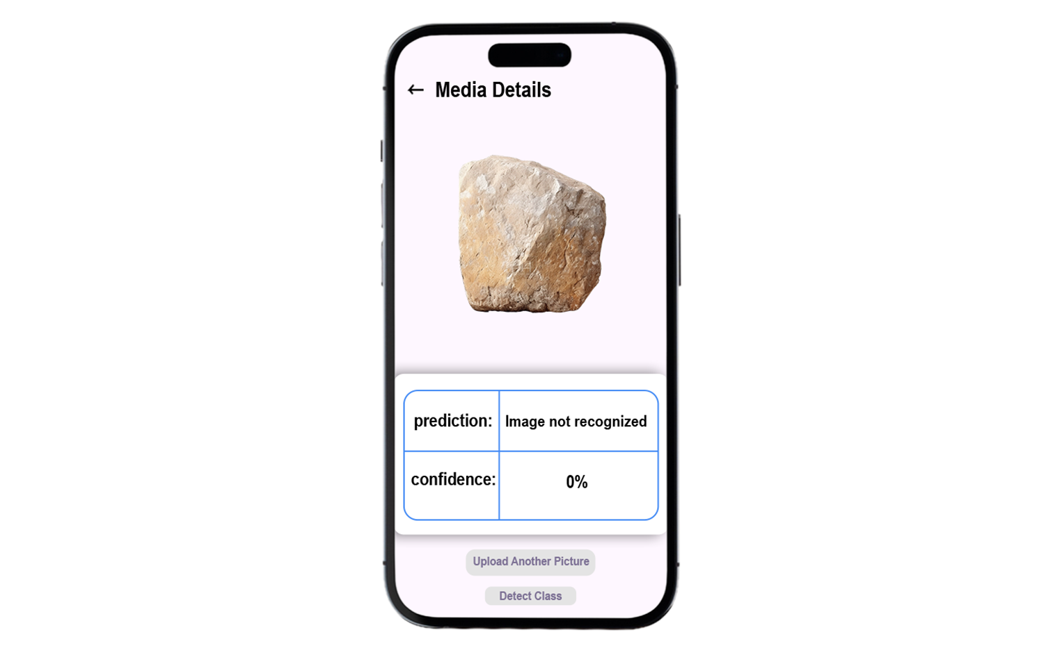
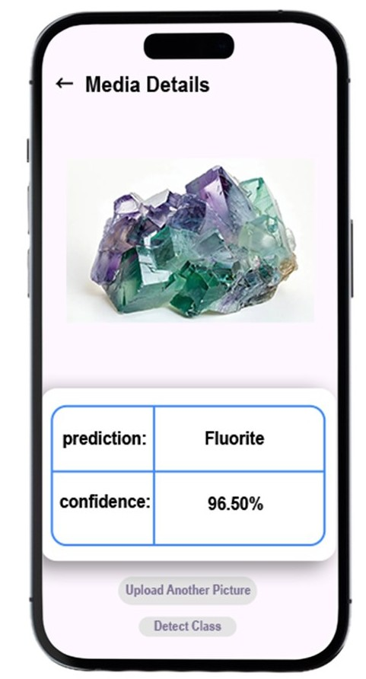
Mobile App
V1

Slide 41
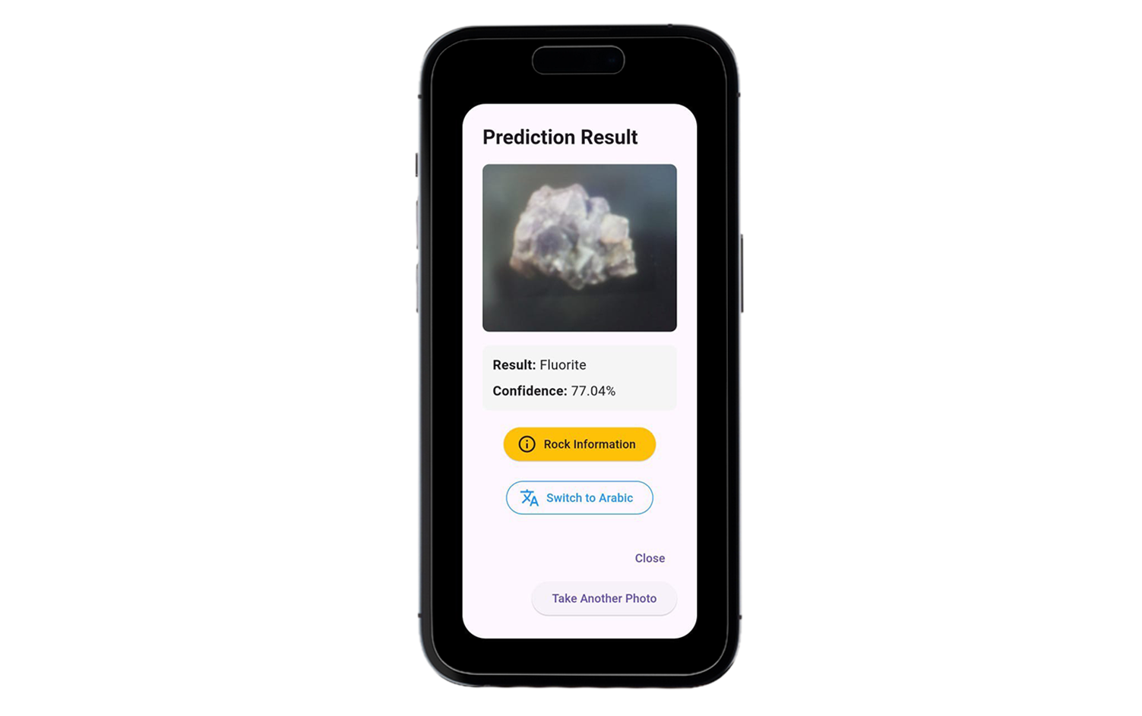
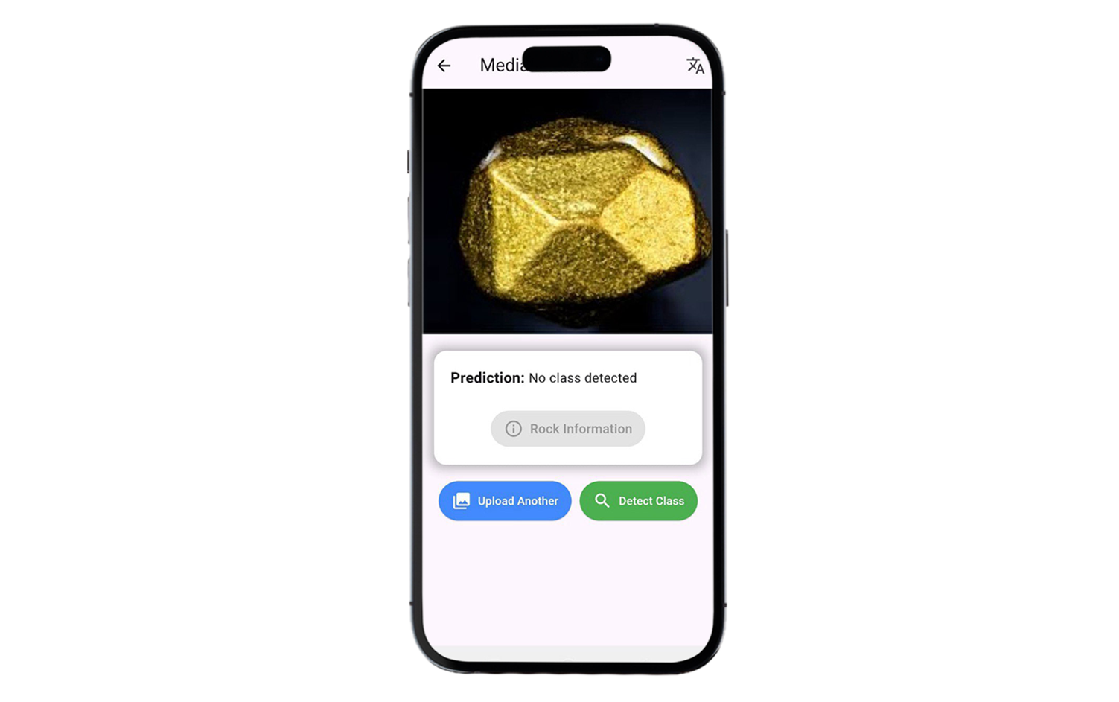
Mobile App
V2

Slide 42
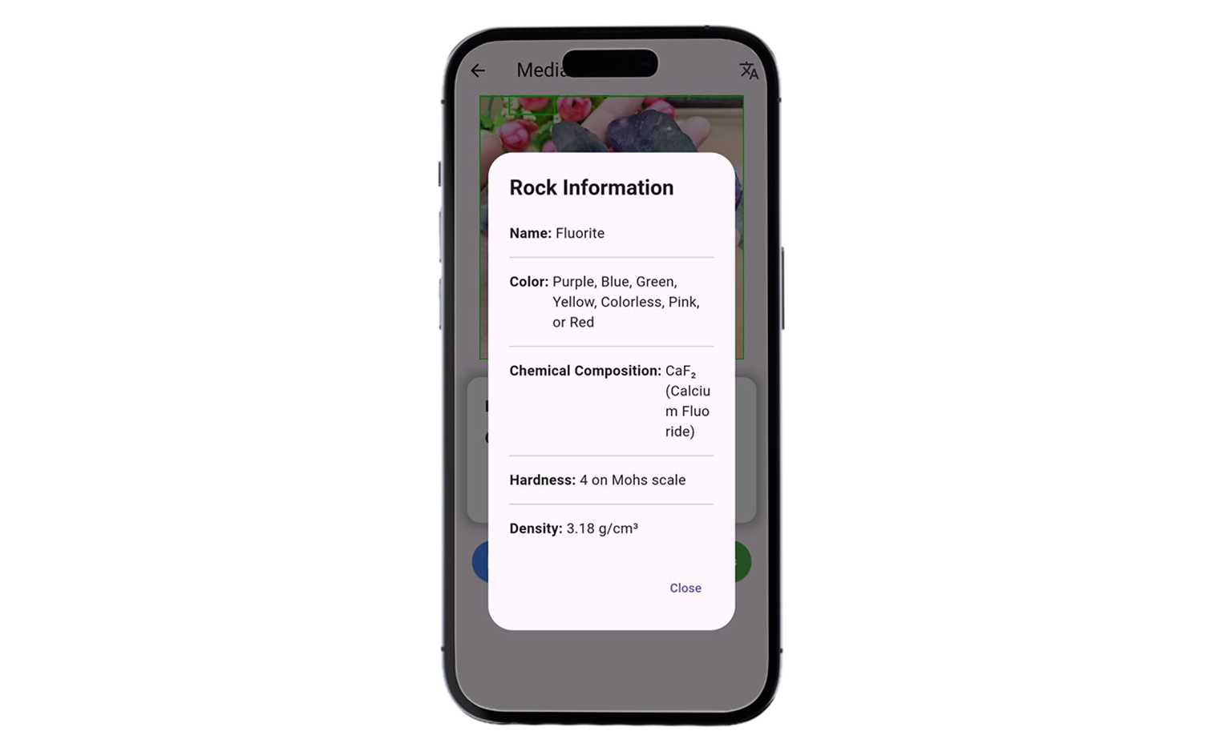
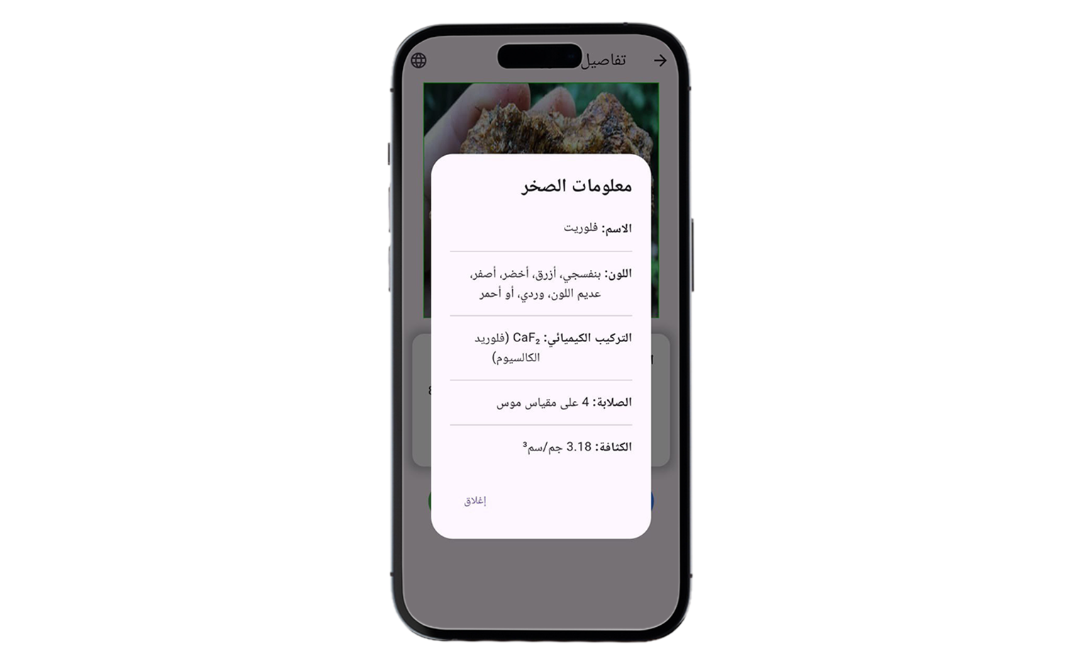
Mobile App
V2

Slide 43

Link between Ai model & Mobile App
Using flask library, we could link between Ai & mobile app, So What is flask ?
Flask is a lightweight and flexible web framework for Python used to build web applications. It follows a minimalistic approach, providing essential tools for routing, request handling, and templates.

Slide 44

Tools For Website Development
Tools

Slide 45
Front-End
HTML
CSS
Java Script
CSS was used to create responsive and visually appealing layouts and was used to control the visual presentation of HTML elements
Using HTML, we developed the full structural framework of the website, which consists of multiple well-linked pages, clearly defined navigation sections, interactive buttons and structured tables to display and manage data efficiently
JS was used to add interactivity and dynamic behavior to webpages

Slide 46
Back-End
.NET
C#
SQL Server
The primary language for developing back-end through .NET framework and writing the code
Used to benefit from its features like MVC to write the back & front end in the same class, EF-Core that is ORM to interact with database and controller class that handle all actions and function
JS was used to add interactivity and dynamic behavior to webpages

Slide 47
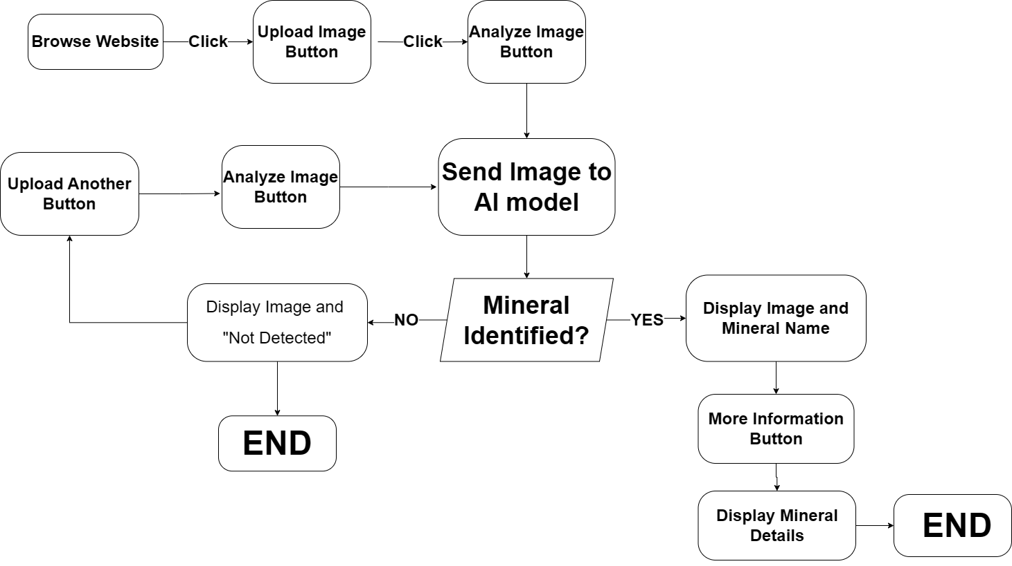
System Architecture

Slide 48
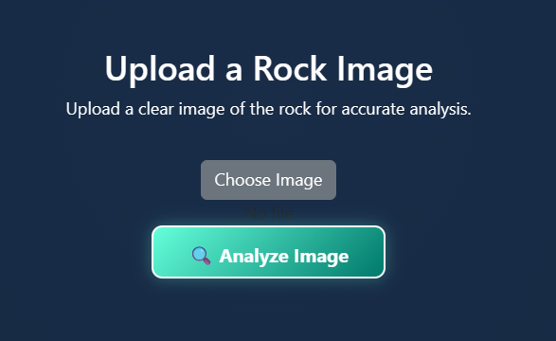
Website
Home Page
Choose Image button
Analyze Image button
This button make the user able to select
a picture through its device to be analyzed
This button sends the selected image to the AI model to analyze it

Slide 49
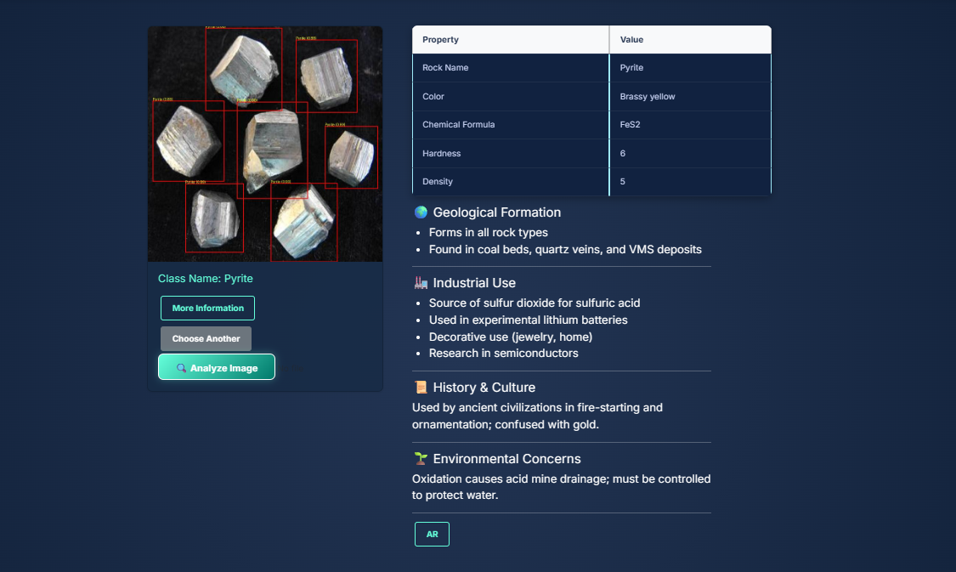
Result Page

Slide 50
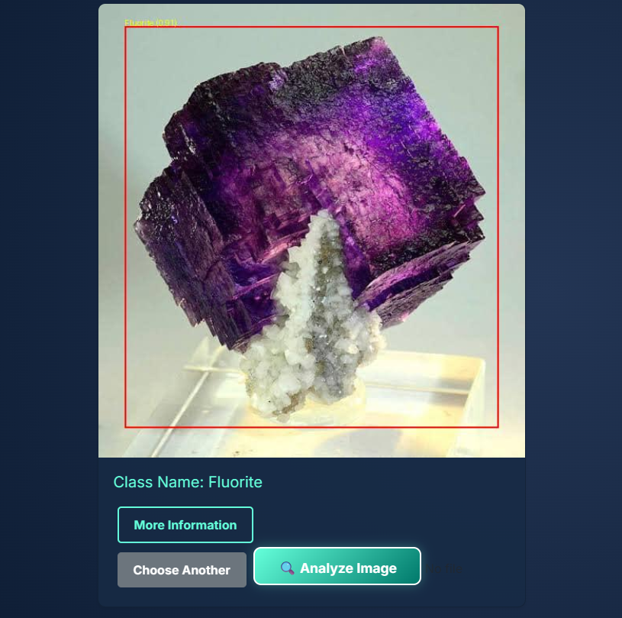
Result Page
Class name Represents the class of the selected Image
Choose Another button: if the selected image could not be analyzed user can select another image using this button
Analyze Image button : Send the selected image to the AI model to analyze it
More Information button : Display more information e.g.( color , Chemical Formula , Hardness)

Slide 51
Data Overview
Dataset Description
Data Splitting
Data Preprocessing Steps
Distribution of Classes
Challenges in Data

Slide 52
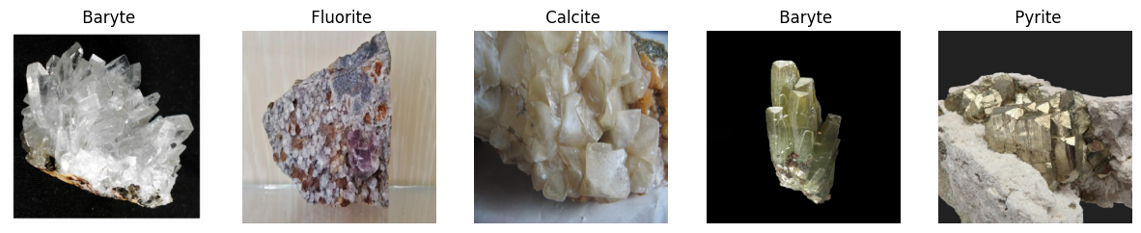
Data Overview
1. Dataset Description
The dataset consists of images of four rock types:
Baryte
Calcite
Fluorite
Pyrite
Collected from Roboflow, pre-processed, and organized into structured directories.
Each image has a resolution of 640x640 pixels, resized to 450x450 for efficient training.

Slide 53
Mineral Identification
Class | Number of Images
Baryte | 1998
Calcite | 2000
Fluorite | 1997
Pyrite | 1999
Classes:
The dataset includes four mineral classes.

Slide 54
2. Data Splitting
Training Set (75%) – Used to train the model.
Validation Set (15%) – Used to tune hyperparameters and prevent overfitting.
Test Set (10%) – Used to evaluate final model performance.
3. Data Preprocessing Steps
Resizing: Images resized to 450x450 pixels.
Normalization: Pixel values scaled to the range [0,1] for faster convergence.
Augmentation: For the training set, we apply data augmentation using ImageDataGenerator from Keras. This includes transformations such as rotation, width/height shift, zooming, and flipping to artificially expand the training dataset and improve model generalization.
Handling Missing Values: Checked and verified completeness of data.
The dataset is divided into three parts to ensure
proper training and evaluation:
To ensure high-quality input for the model, the
following preprocessing steps were applied:
.
Data Overview

Slide 55
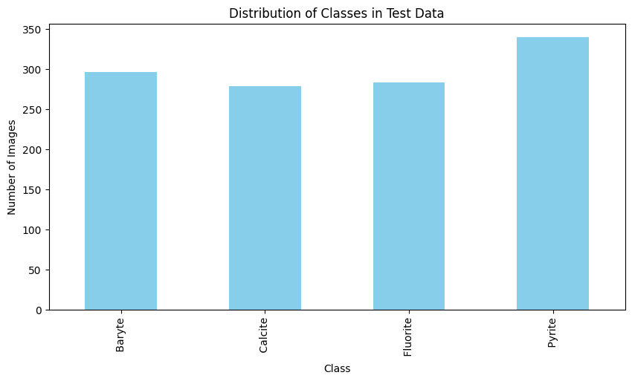
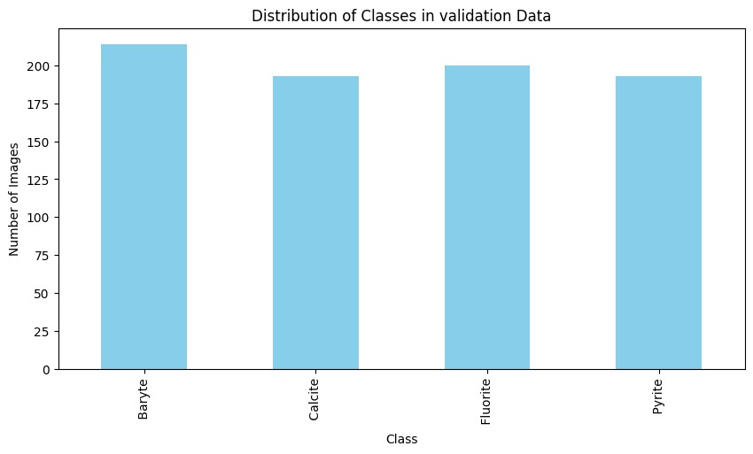
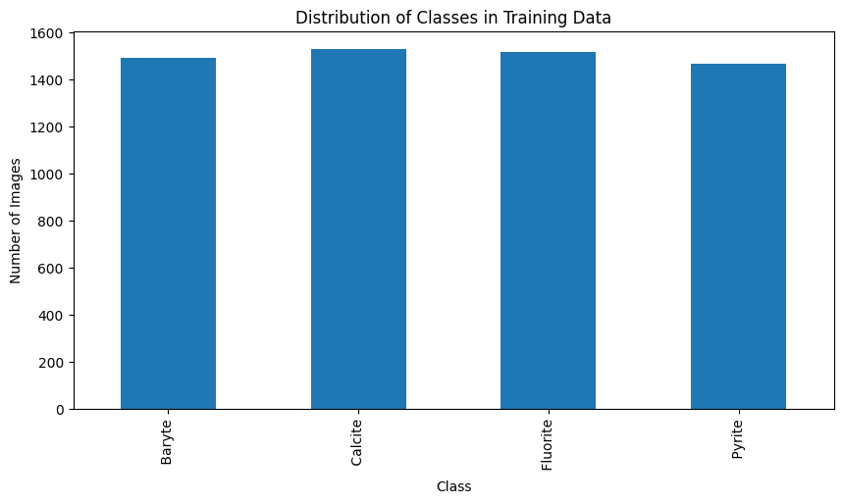
Data Overview
4. Distribution of Classes:
ensuring balanced data distribution. A bar chart visualization of class distribution shows uniformity across classes.

Slide 56
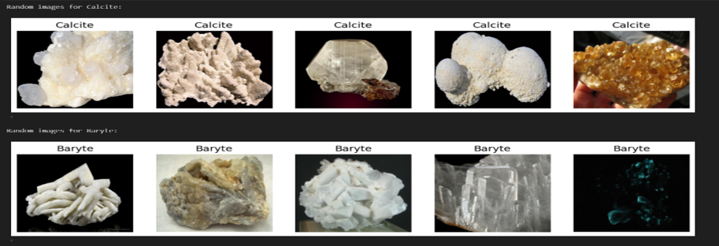
Data Overview
5.Challenges in Data
Visual Similarity: Some rock types (e.g., Calcite vs. Baryte) have similar textures, causing classification difficulties.
Image Quality: Some images have variations in lighting and background, affecting consistency.

Slide 57
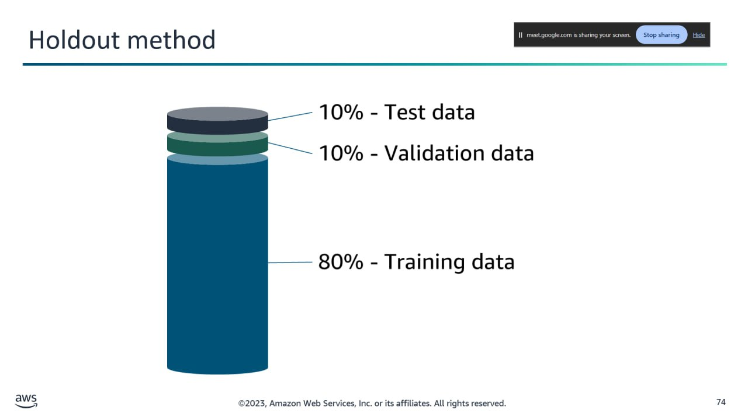
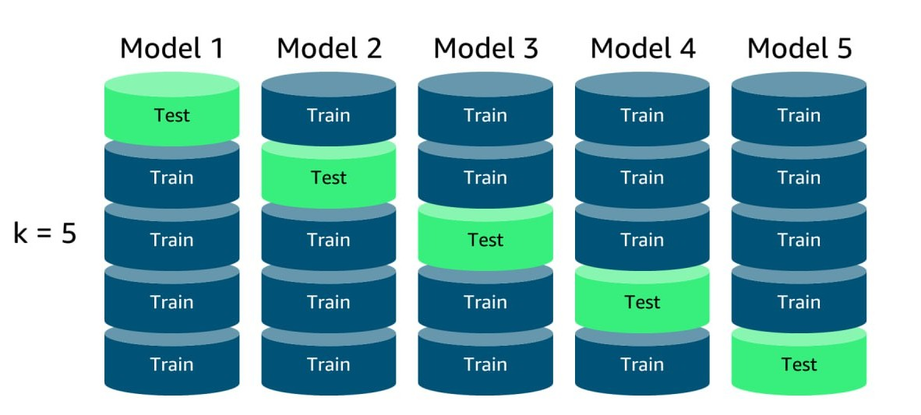
Splitting Techniques
Holdout
Method
K-Fold Cross Validation

Slide 58
Model | Validation Accuracy | Validation Loss | Test Accuracy | Spliting Used
Resnet-50 | 98% | 0.056 | 83% | K-Fold Cross Validation
Inception V3 | 85% | 0.5 | 85% | Holdout
VGG-19 | 73% | 0.82 | 71% | Holdout
Models Results

Slide 59
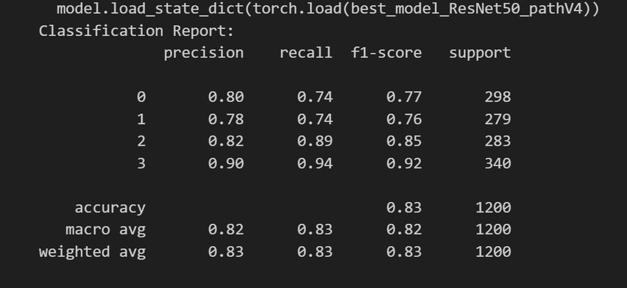
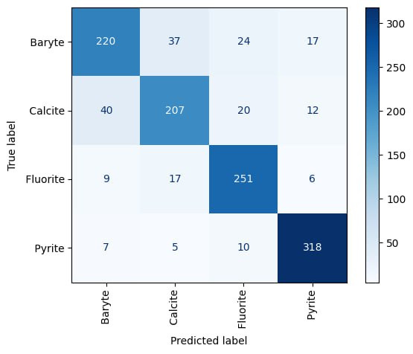
Models Evaluations and performance
Resnet-50
Performance

Slide 60
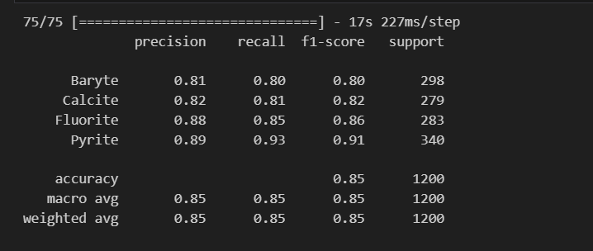
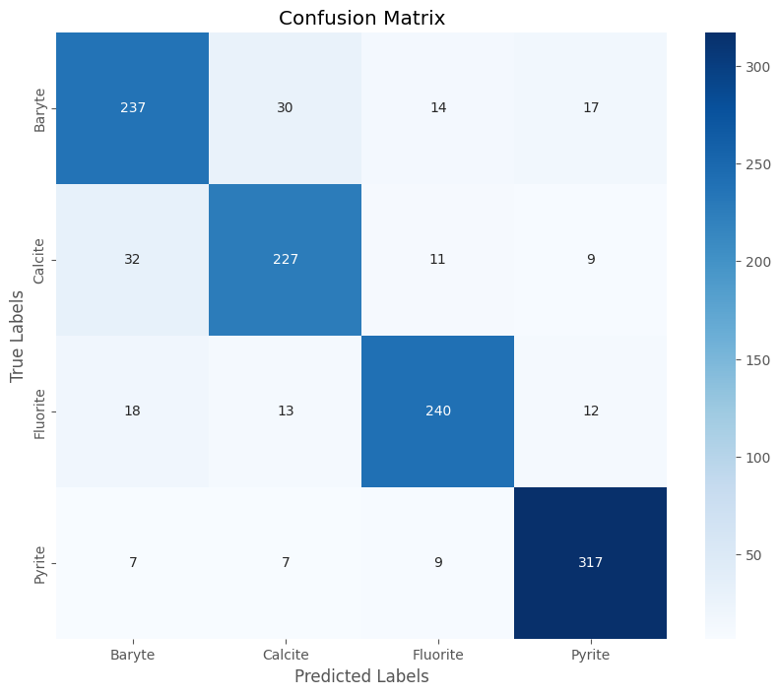
Models Evaluations and performance
Inception-v3 Performance

Slide 61
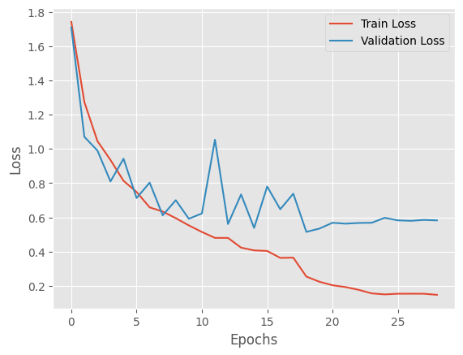
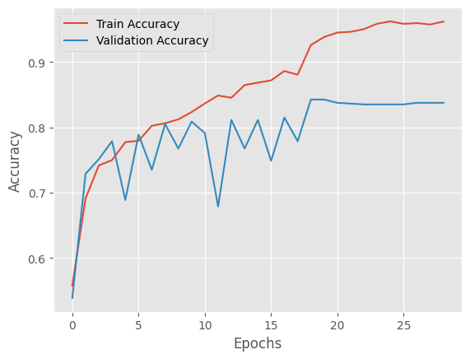
Models Evaluations and performance
Inception-v3 Performance:

Slide 62
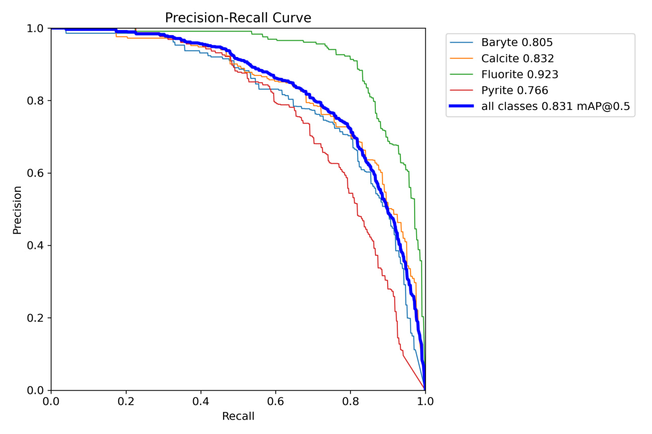
Models Evaluations and performance
YOLOv11 Performance:
Notes:
This Precision-Recall Curve evaluates our YOLOv11m model’s performance across four mineral classes. Fluorite achieves the highest average precision at 92.3%, while Pyrite lags slightly at 76.6%. The overall model performs robustly with a mean Average Precision (mAP) of 83.1% at an IoU of 0.5, indicating high-quality detection and localization of minerals.

Slide 63
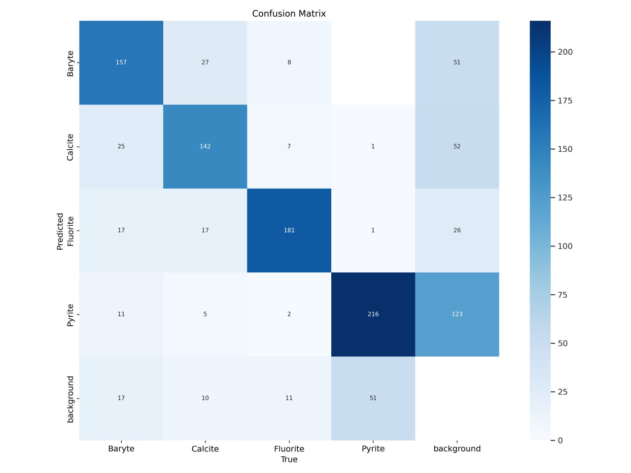
Models Evaluations and performance
YOLOv11 Performance:

Slide 64
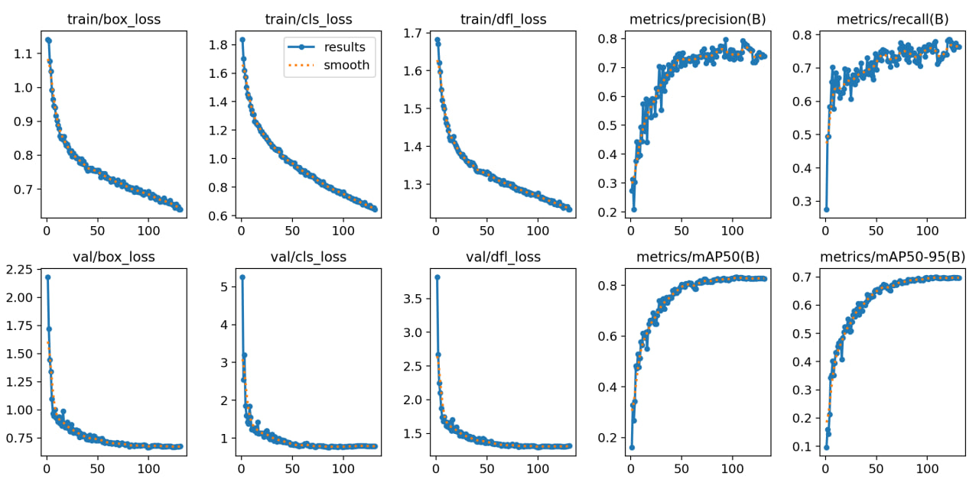
Models Evaluations and performance
YOLOv11 Performance:
Notes:
Train Box Loss: This curve shows the training loss for bounding box predictions, decreasing from 1.1 to 0.7 over epochs, indicating improved accuracy in detecting rock locations.
Train Class Loss: The classification loss during training drops from 1.8 to 1.3, reflecting better differentiation between rock types (Baryte, Calcite, Fluorite, Pyrite) over time.
Train DFL Loss: This loss, decreasing from 1.7 to 1.4, measures the distribution focal loss, enhancing the model’s focus on hard examples during training.
Metrics Precision (B): Precision rises from 0.4 to 0.8, showing the model’s increasing ability to correctly identify rocks while reducing false positives.
Metrics Recall (B): Recall improves from 0.3 to 0.8, indicating the model detects a higher proportion of actual rocks in the images over epochs.
Val Box Loss: Validation box loss decreases from 2.25 to 1.25, confirming the model generalizes well in predicting rock bounding boxes on unseen data.
Val Class Loss: The validation classification loss drops from 5 to 1, suggesting robust generalization in classifying rock types across validation sets.
Val DFL Loss: This validation loss falls from 3.5 to 1.5, reinforcing the model’s improved handling of complex examples in the validation phase.
Metrics mAP@0.5: Mean Average Precision at 0.5 IoU increases from 0.6 to 0.8, highlighting strong overall detection performance across all rock classes.
Metrics mAP@0.95: mAP at 0.95 IoU rises from 0.1 to 0.7, indicating good precision even at higher overlap thresholds, though further improvement is needed.

Slide 65

Demo

Slide 66

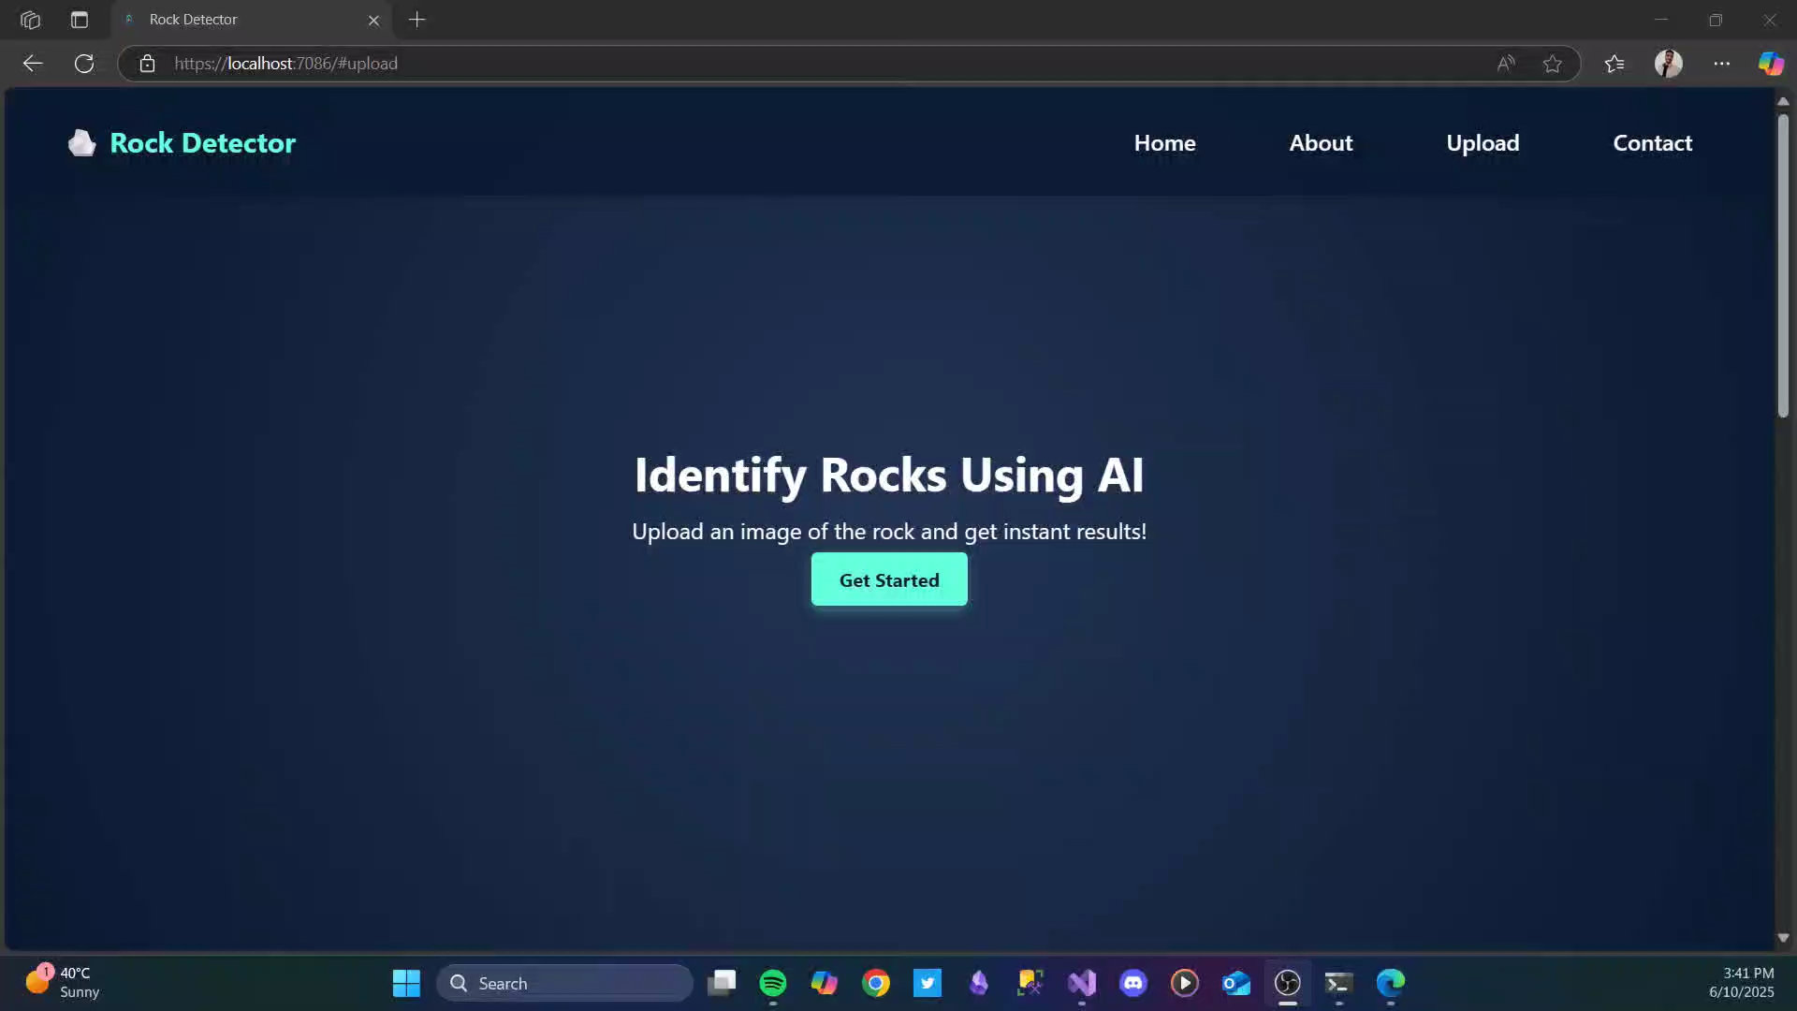

Slide 67
References

Slide 68

[1] Chengzhao Liu, Mingchao Li, Ye Zhang, Shuai Han, and Yueqin Zhu , “Classifying Minerals using Deep Learning” 26 August 2019 [2] Weihao Chen, Lumei Su, Xinqiang Chen, and Zhihao Huang.“Earth Science and its Role in the Future of Mineral Exploration “ 6 January 2023 [3] Dalchand Jhariya ( MTech, PhD Professor ) , “Classifying Minerals using Deep Learning Algorithms “ , June 2022 [4] Paolo Dell’Aversana, Eni S.p.A., San Donato Milanese, Italy ,“Classifying Minerals using Deep Learning Algorithms” , 22 April 2023 [5] Teng Long 1ORCID,Zhangbing Zhou , “Classification of Minerals using Deep Learning , 29 August 2022 [6] PHD Hooman Dadashzadeh Ahari , “Unsupervised Learning and Mineral Classification ” , 30 August 2024

Slide 69


Any Question ??
Thank You

